Slide 1

Sales Analysis of Retail Stores
NAME:ABIJAH DIONYSIUS.R

Slide 2

Table of Contents
Introduction
Methodology
Results
Discussion
Conclusion
Appendix
Stock ID: 47857043

Slide 3

Introduction

Slide 4

Introduction
The business objective is to perform an in-depth analysis of the retail chain's sales performance across various regions and timeframes. The goal is to uncover key factors affecting sales, such as store locations, product categories, and promotional efforts. By deriving actionable insights, i will support strategic decision-making and drive business growth.
To maintain a competitive advantage and optimize performance, the organization is committed to utilizing data-driven insights to refine sales strategies and improve operational efficiency.

Slide 5

Methodology

Slide 6
Data Details
When I downloaded the data first I went back & forth to understand it’s format,structure,size of the dataset before jumping into the task
The dataset consist of the following files sales.csv, product_hierarchy.csv, store_cities.csv, store_names.csv, city_names.csv, and product_names.csv.
Where sales.csv is the target file to analyse and derive insights.sales.csv consist of the date of purchase, productid information,storeid information , types of promo-code, revenue, stock & price information
product_hierarchy.csv and product_names.csv consists of product category, product names, product id which is a unique identity for each product.
store_names.csv & store_cities.csv consists of storeid info and storetypeid info to cityid to establish the relationship between variables.
city_names.csv consists of cityid info and city names

Slide 7
Module 1: Data Cleaning and Preparation Using Excel
The first and foremost step before getting meaningful insight is to clean the junk out of the dataset. For this I used the tool excel which is a great tool for data analysis
Step1: Identifying missing values is crucial step to any data-driven business. If not handled properly it may lead to wrong decision making. So using filter feature filtered the columns where the data is null and removed them from the dataset.
Step 2:Use Excel's Remove Duplicates feature to find and eliminate duplicate records within your data. Only unique values remain in the dataset for further analysis. This method ensures data integrity
Step 3: To format data across the worksheet to maintain it is consistent and presentable format
Ex: date, formatting data of numerical to 2 decimal places.
Step 4: To remove blank spaces from the data column and formatting the data to uppercase and adding spaces where there is no space to maintain uniformity. Trim() function in excel does that work.
The above steps are repeated across all dataset to clean the data.

Slide 8
Module 2: Data Querying and Analysis Using PostgreSQL
Now jumping into the postgresql we have to follow certain steps to inject the data into the server which is
Step 1: create the database and tables and populate them with the data in the BI-dump.sql file. The dump file consists of the sales.csv,product csv etc.….
Step 2: Within the Command-line interface, a new database named BICapstone is created and connected to the BICapstone database by entering the command, \connect capstone. Restore the BICapstone database tables and data from the BI-dump.sql file using the command \include BI-dump.sql
Step 3: The next step is to verify the loaded data using pgAdmin which is a graphical user interface of PostgreSQL. Executing the query SELECT * FROM table name LIMIT 5; for each table to ensure data is populated correctly.
Step 4: Next is to analyse the data of the sales by using Cubes, rollups which gives the total sales and sales by product, city, & stores.

Slide 9
Module 3: Data Visualization and Statistical Analysis
Statistical analysis is critical in interpretation of the regression statistics . This analysis will give the detailed report on how the sales have performed across all variables such as date,revenue,stock, price.
Step 1:After analysing the data we observe sales as our dependent variable and see how these variables are correlated with sales to see any strong relationship between variables.
Step 2:Now we use regression analysis feature in excel to give summary of the output which will explain the relationship
Step 3:Instead analysing the entire dataset we are going to take some sample from the dataset about 20k rows to analyse. Processing entire dataset might take larger time to produce the output.
Step 4:Interpret coefficients to explain the expected sales change with a one-unit increase in the independent variable.
Step 5:Assess significance levels (p-values) to determine the statistical significance of independent variables.
Step 6:Evaluate the R-squared value to grasp the proportion of variance in sales predictable from the independent variable

Slide 10
Module 4: Data Visualization and Dashboards Using Tableau
Next task is to create interactive dashboard which will depict the entire story in chart form.
Step1: First we import data into the tableau and establish the relationship between variables to bring the desired output.
Step2: Next we add new sheets and make few calculated fields and enter the formula to make our calculation or aggregation easier to apply.
Step3:Next we create few charts like line,chart,barchart,bubblechart to visualize the data.
Step4: after creating the chart in sheets we have to add the sheets to the dashboards to make a compelling story.
Step 5: the final steps is to make some tweaks in the chart so that stakeholders can understand easily by using tableau’s feature filter and highlighters. Filters and highlighters are when a data is clicked in a chart it highlights and filters that partiular in other chart too.

Slide 11
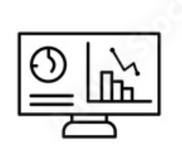
Results

Slide 12
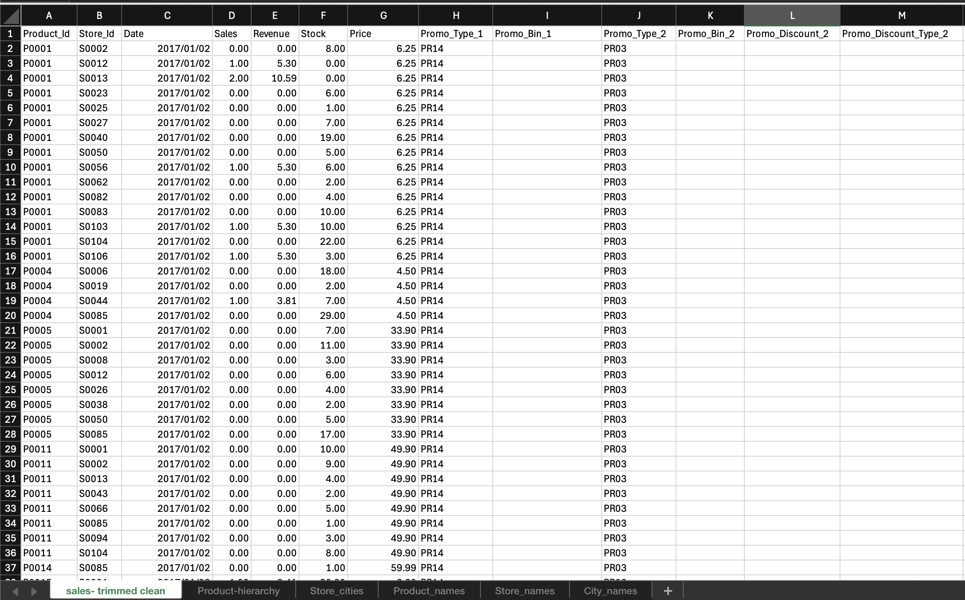
Module 1, Lesson 1: Data Cleaning and Preparation
Data cleaning and preparation are fundamental steps in any data analysis or data science workflow. They ensure that the data is accurate, consistent, and usable for analysis, modeling, and decision-making.

Slide 13
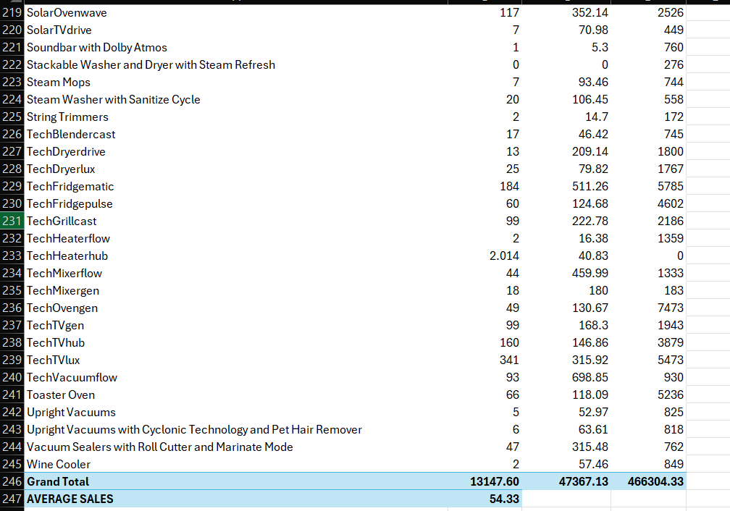
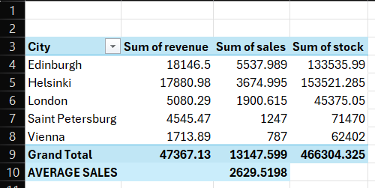
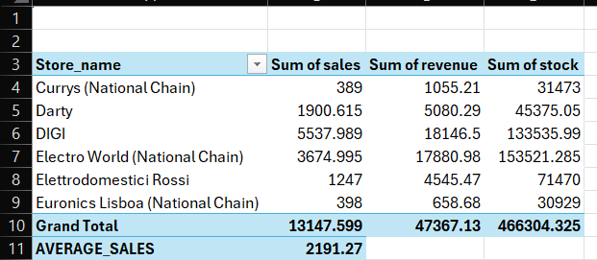
Module 1, Lesson 2: Data Analysis Using Pivot Tables

Slide 14
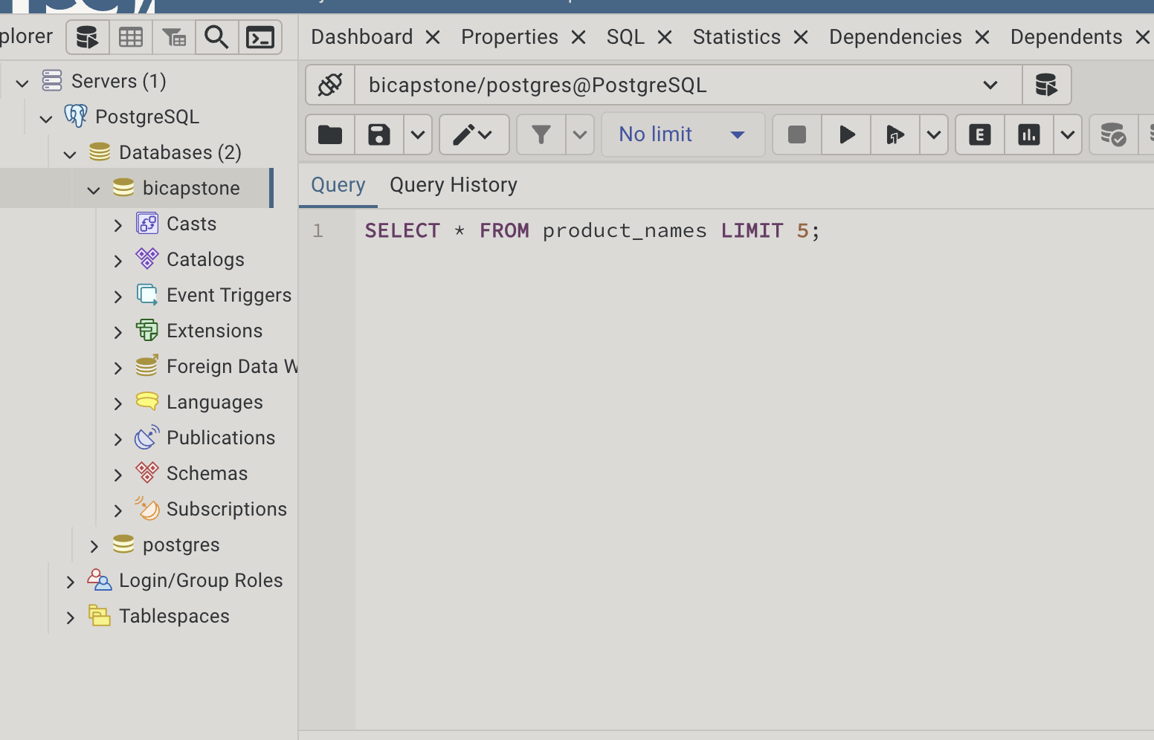
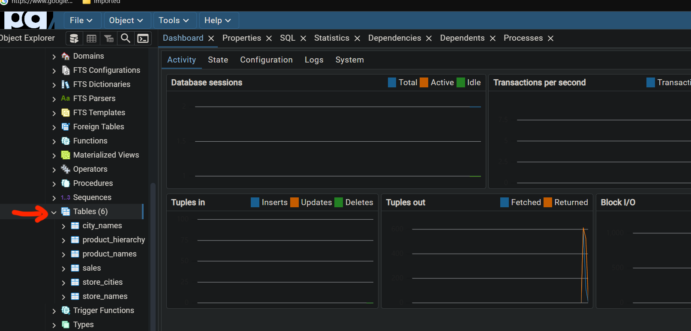
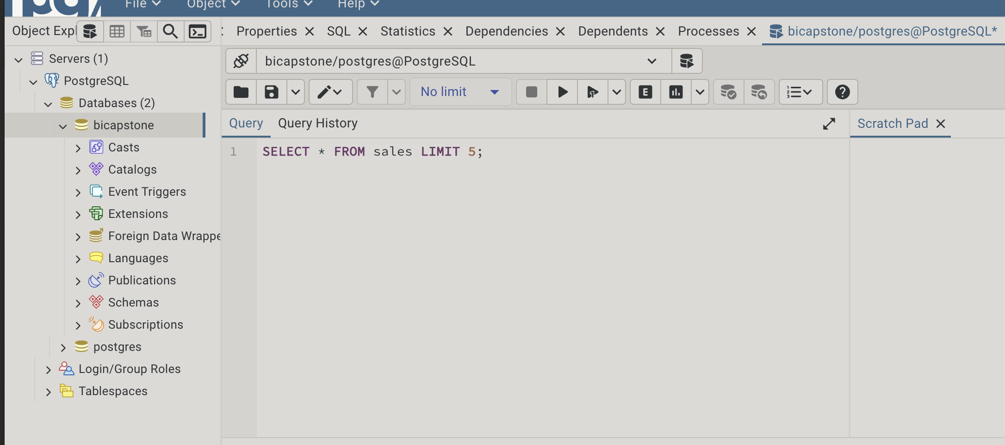
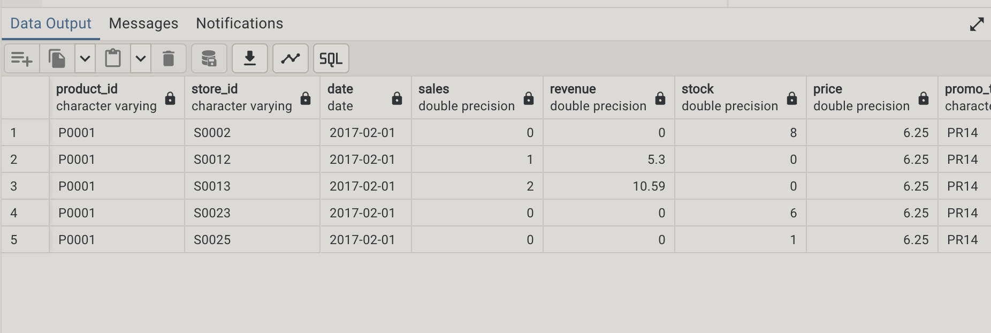
Module 2, Lesson 1: Data Querying Using PostgreSQL

Slide 15
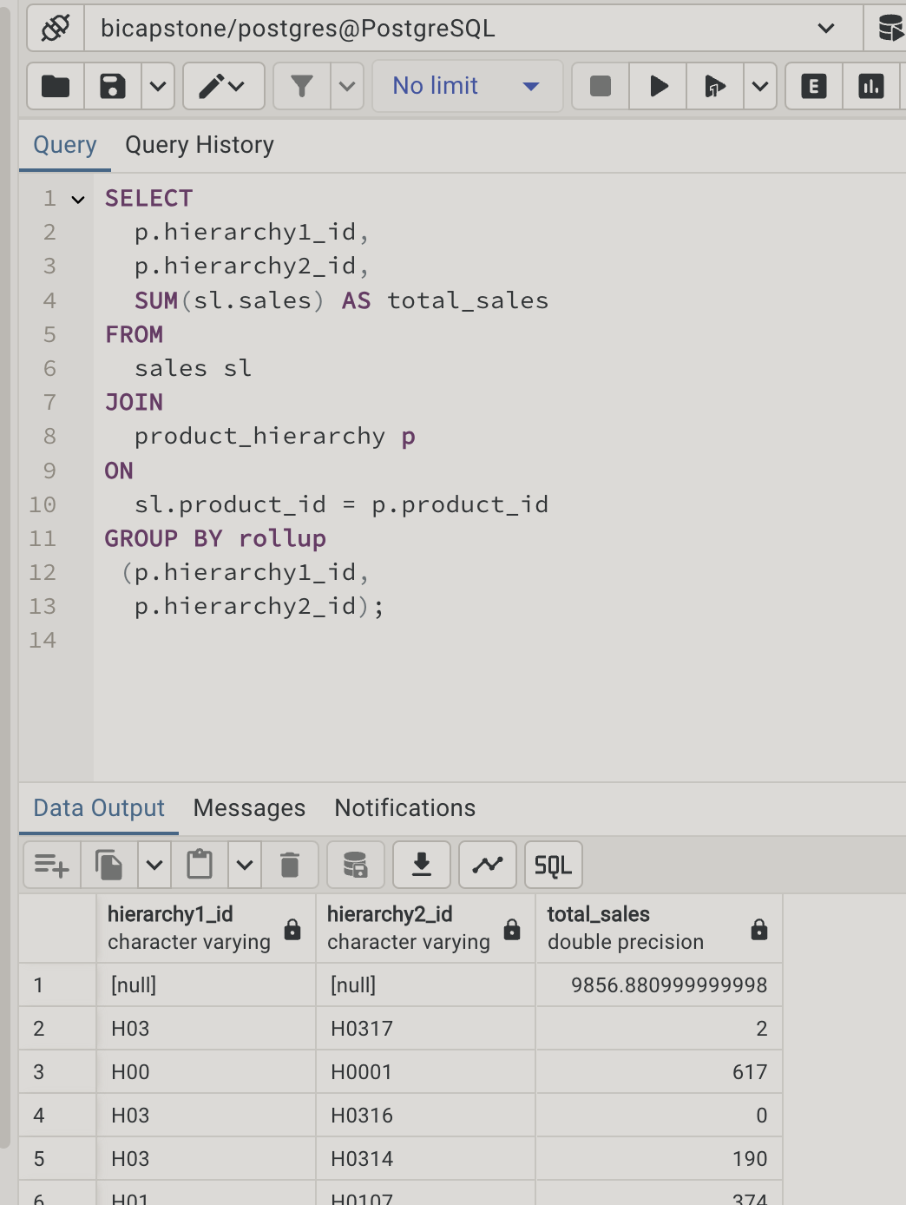
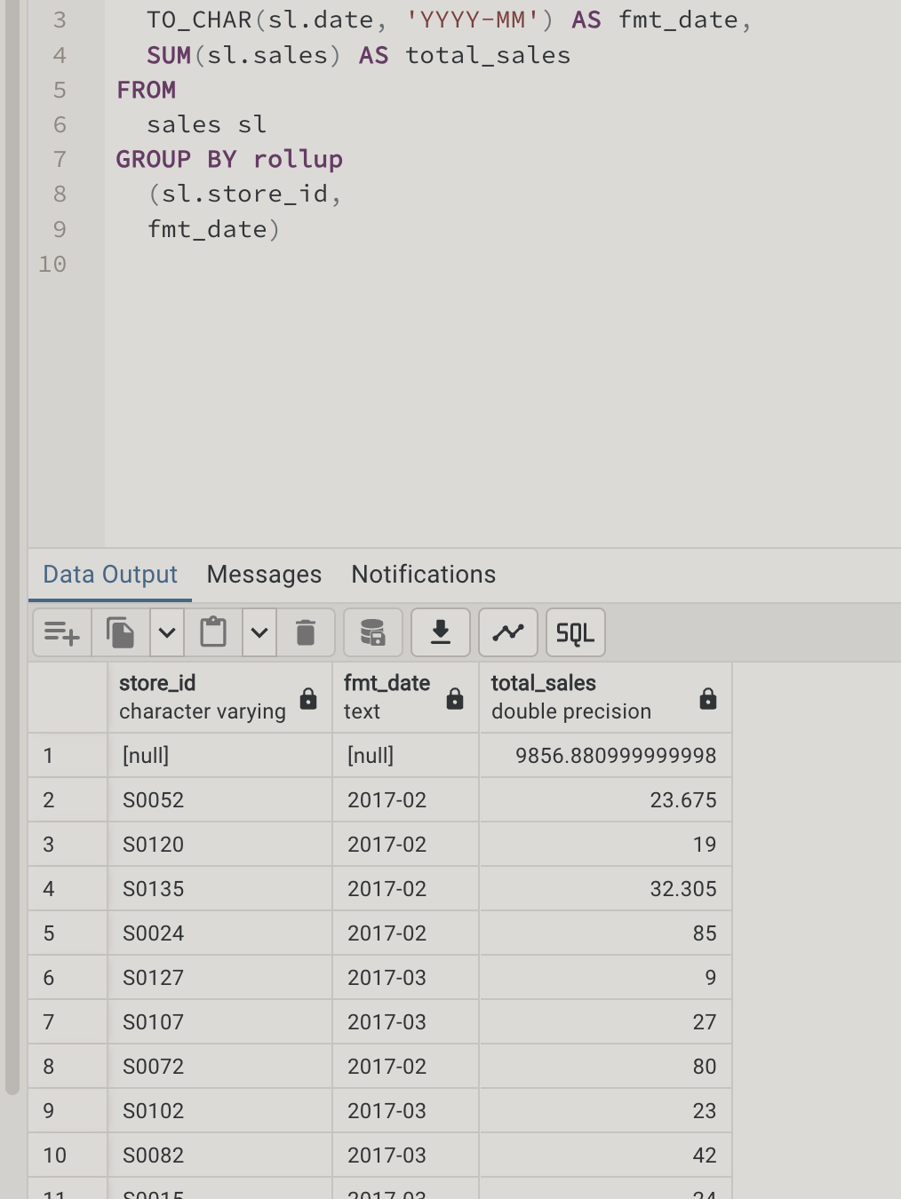
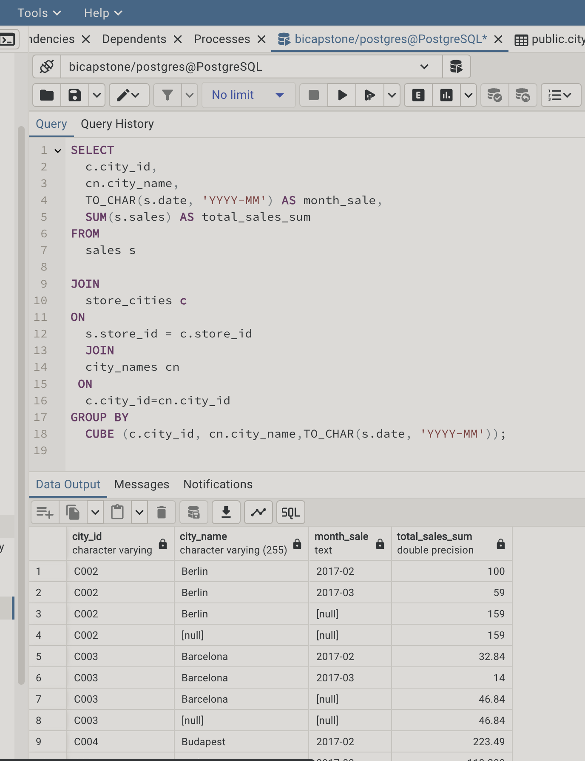
Module 2, Lesson 2: Data Analysis Using PostgreSQL

Slide 16
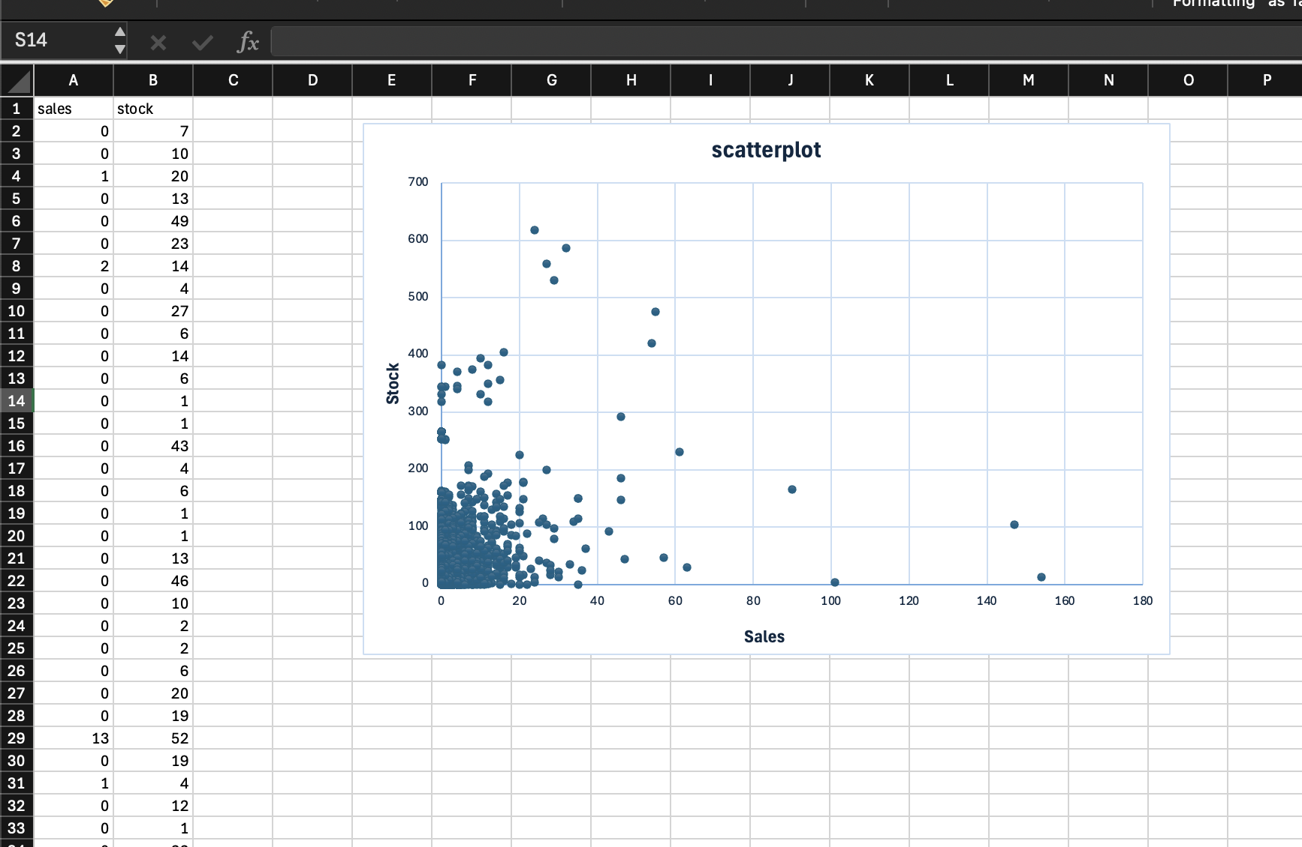
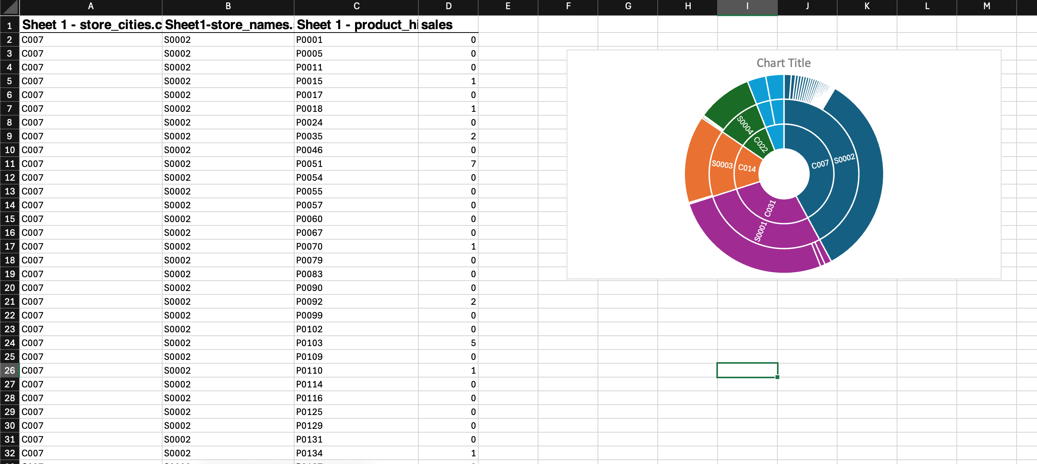
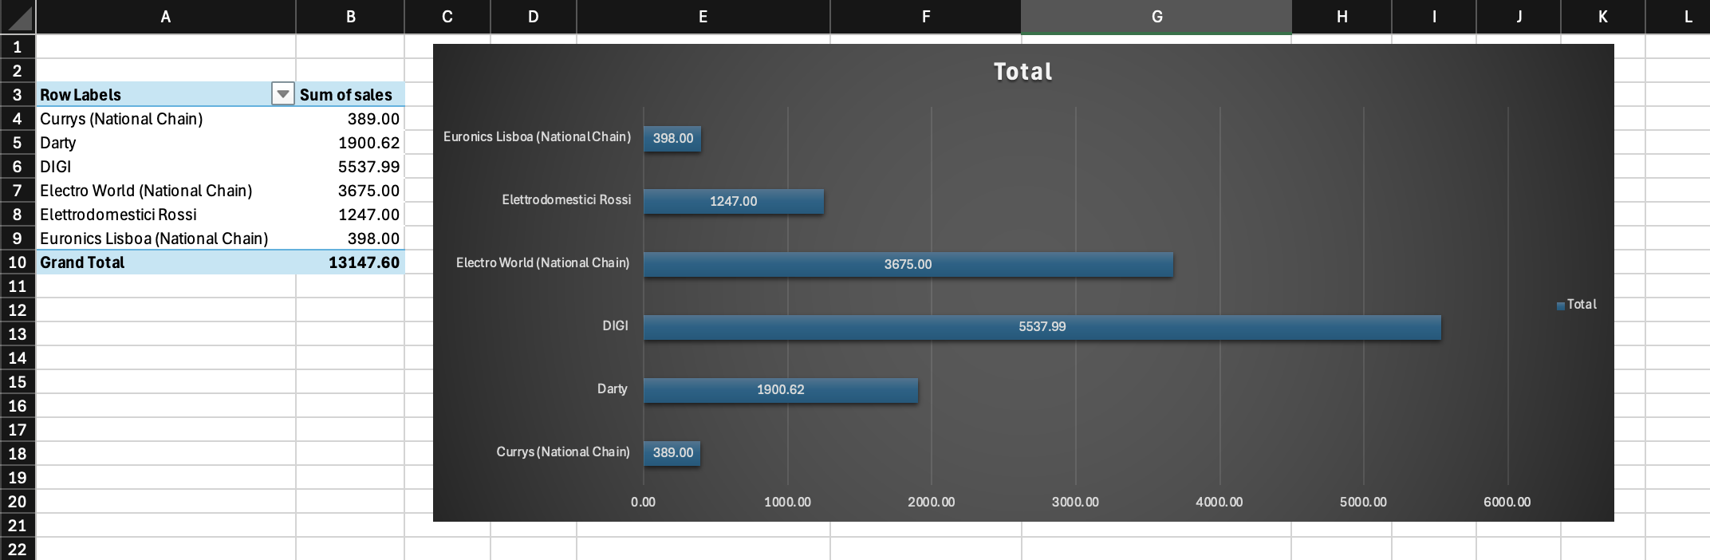
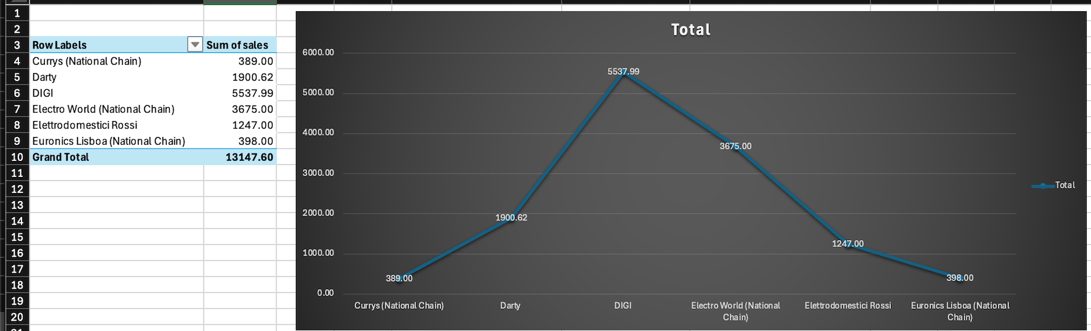
Module 3, Lesson 1: Data Visualization Using Excel

Slide 17
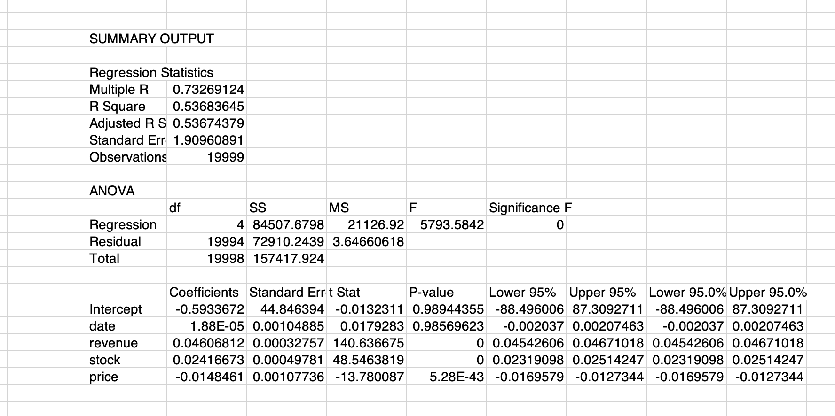
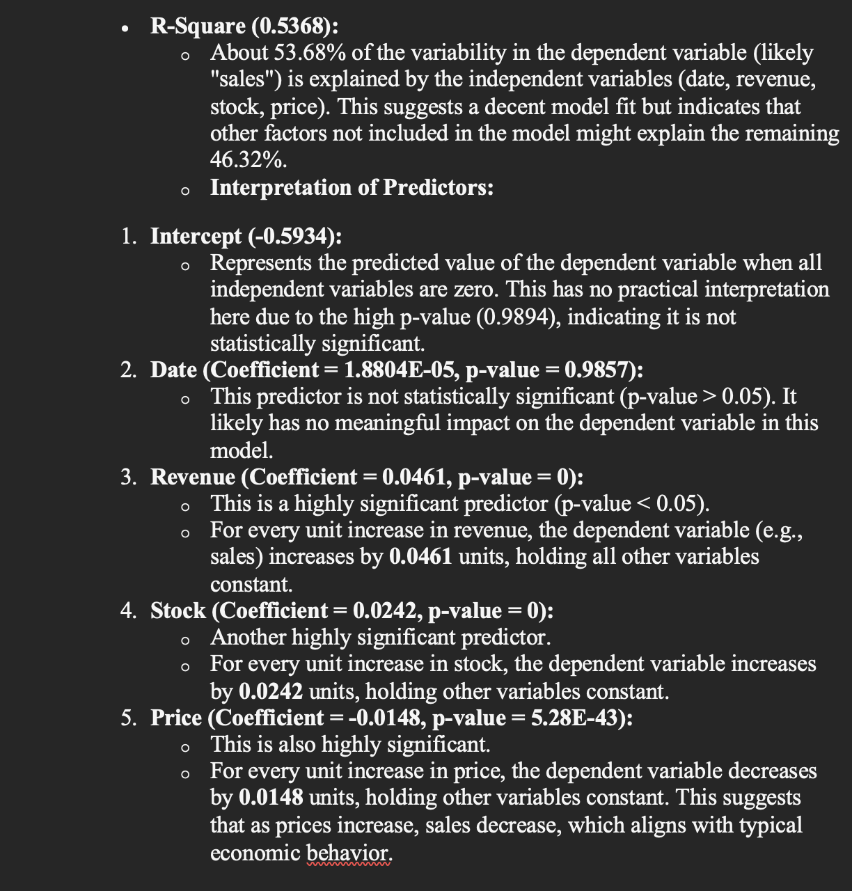
Module 3, Lesson 2: Statistical Analysis
EXPLANATION:

Slide 18
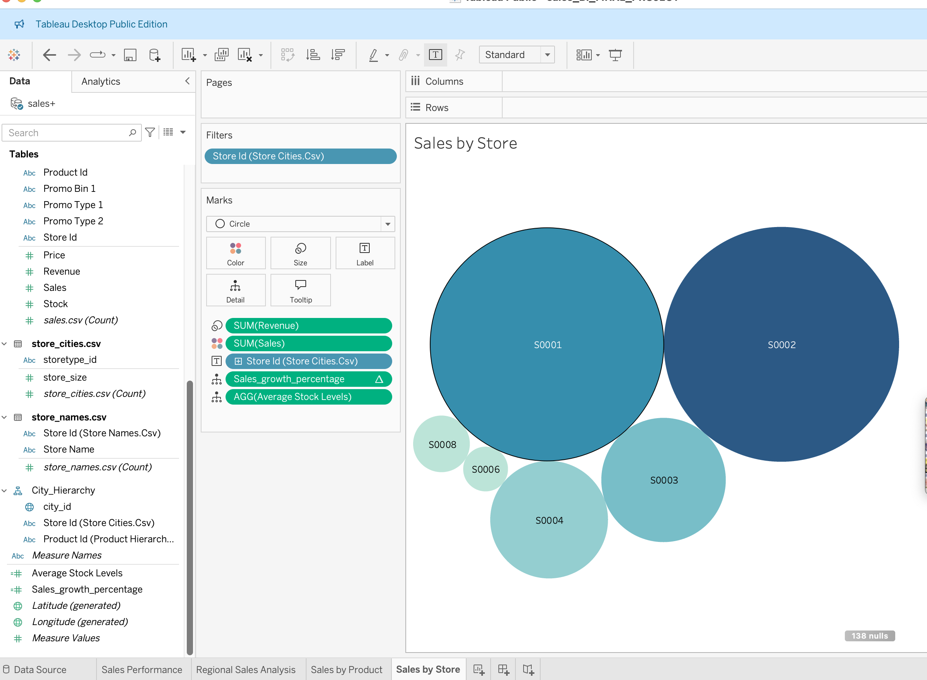
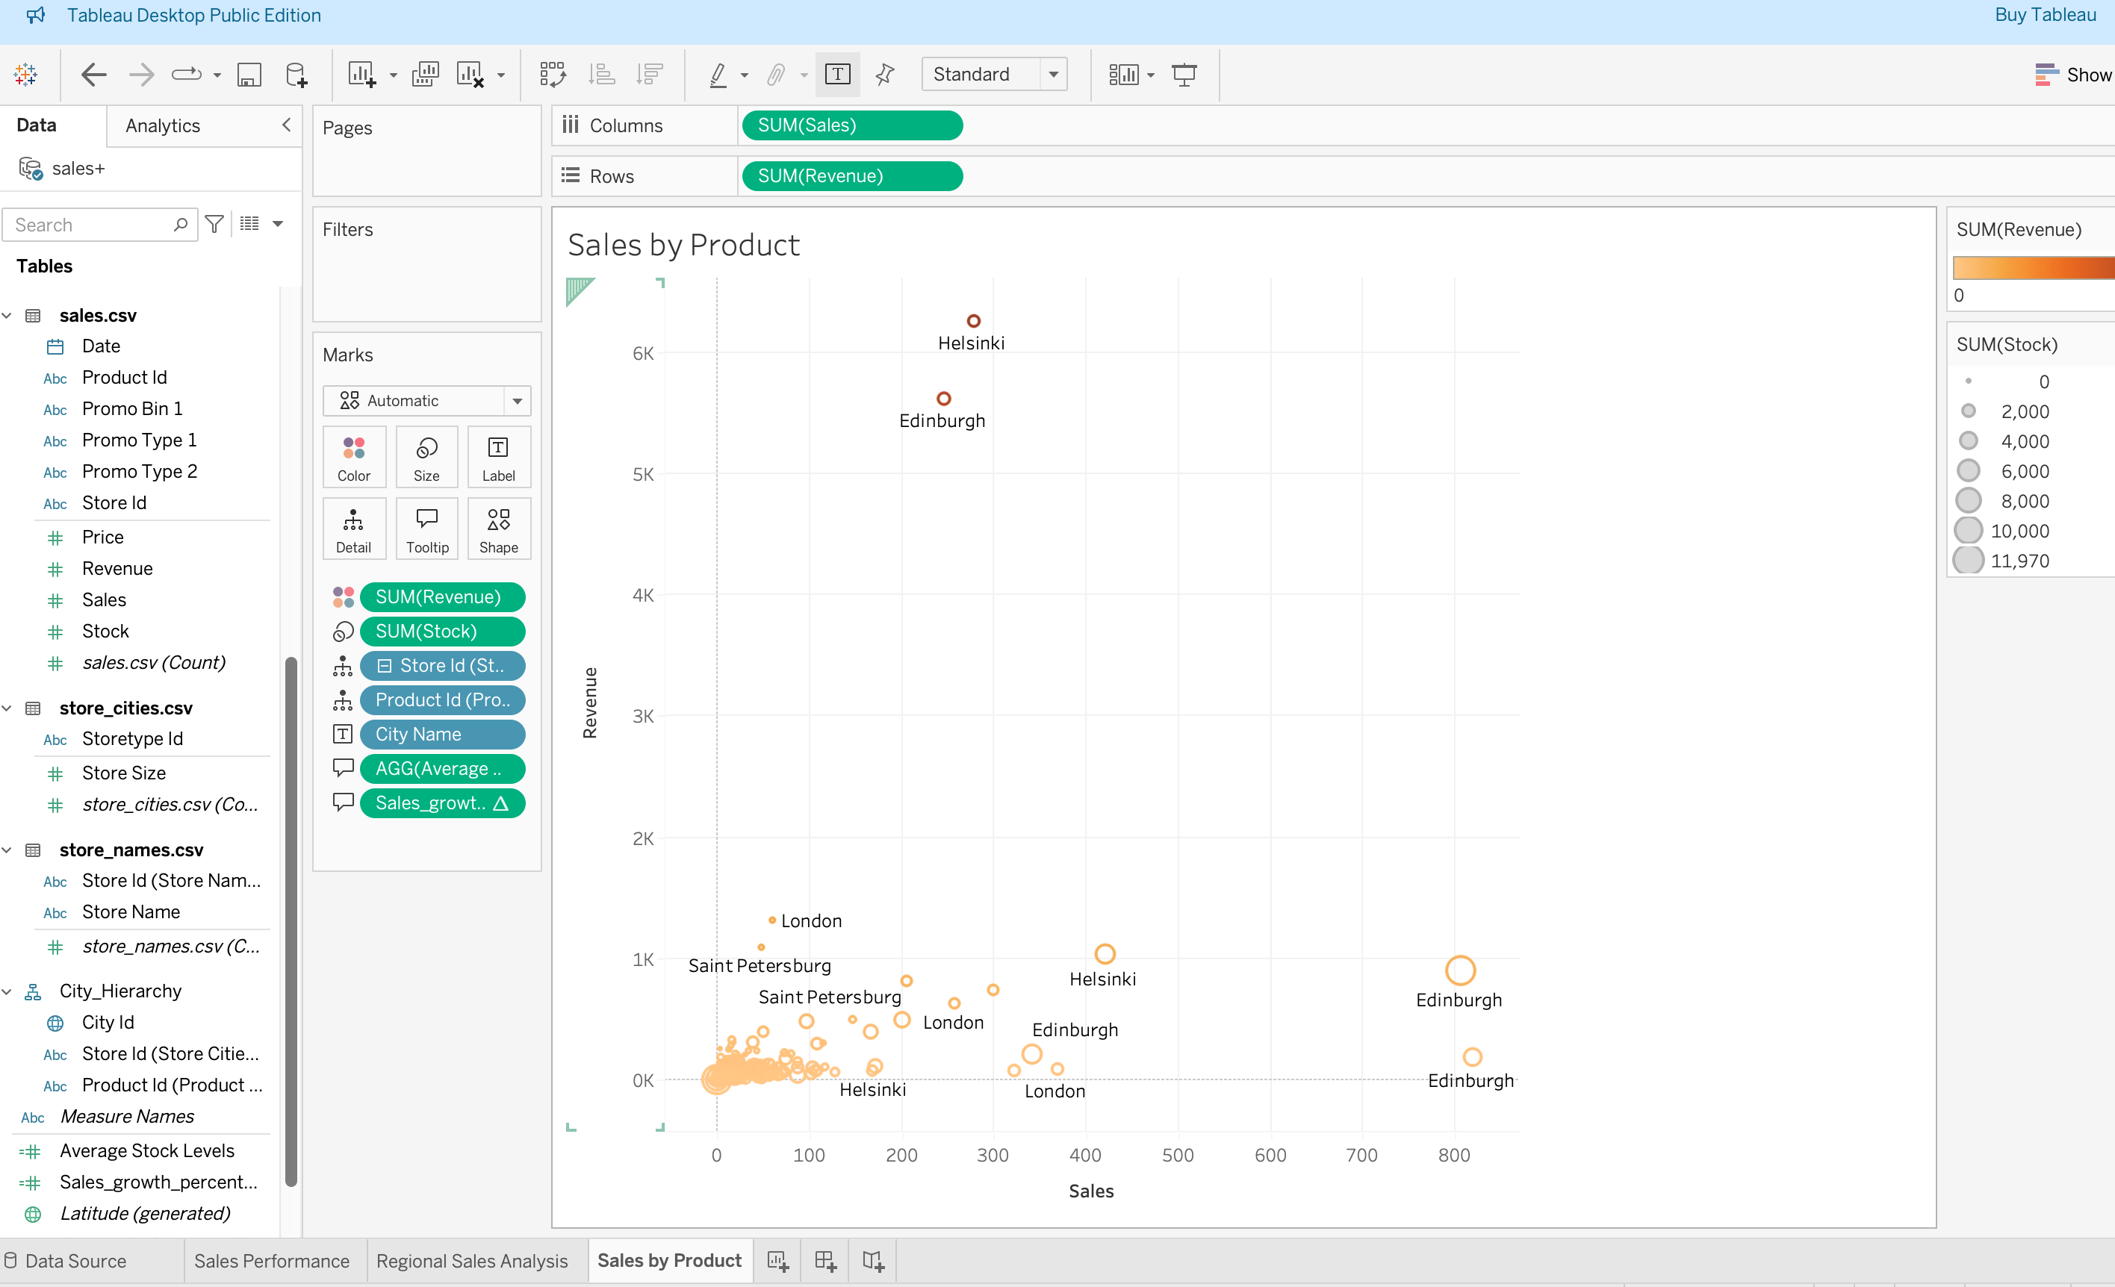
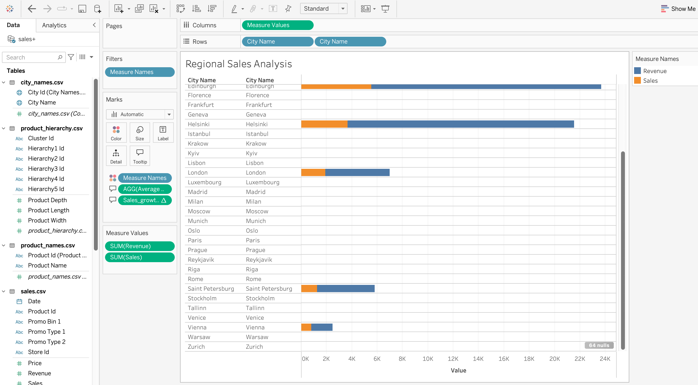
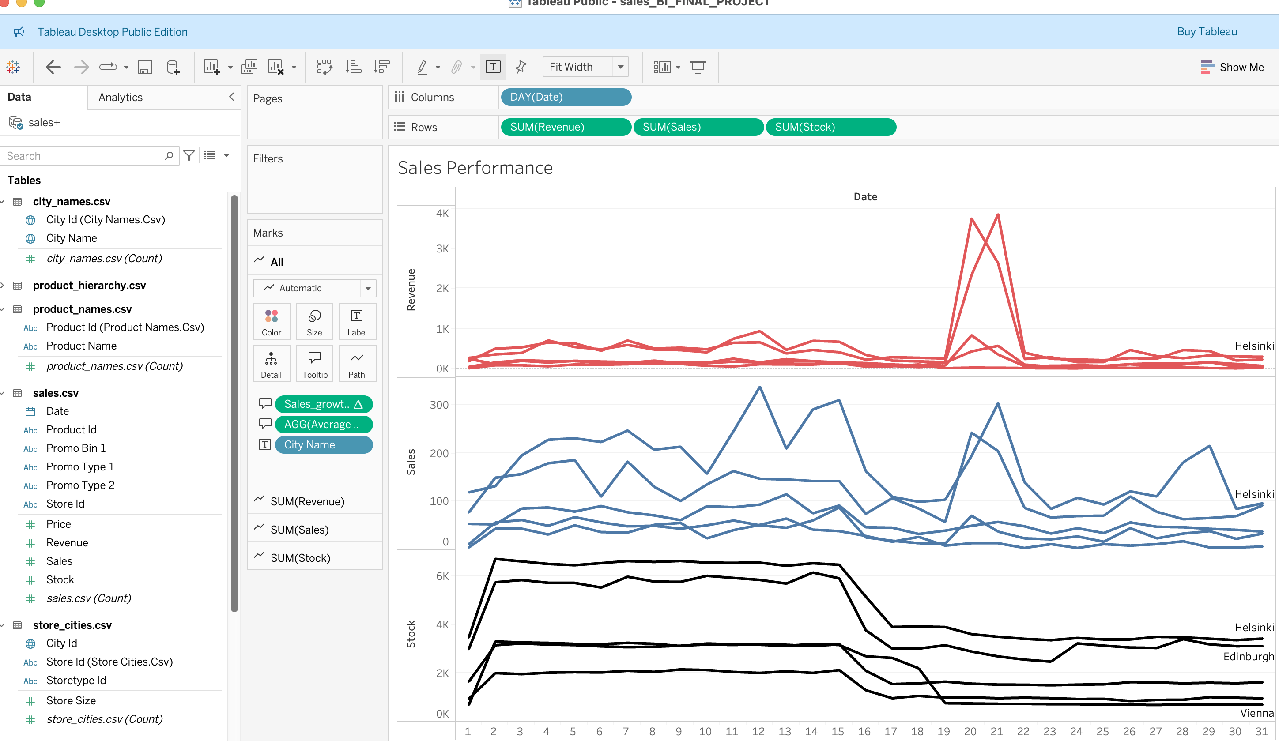
Module 4, Lesson 1: Basic Tableau Visualizations

Slide 19
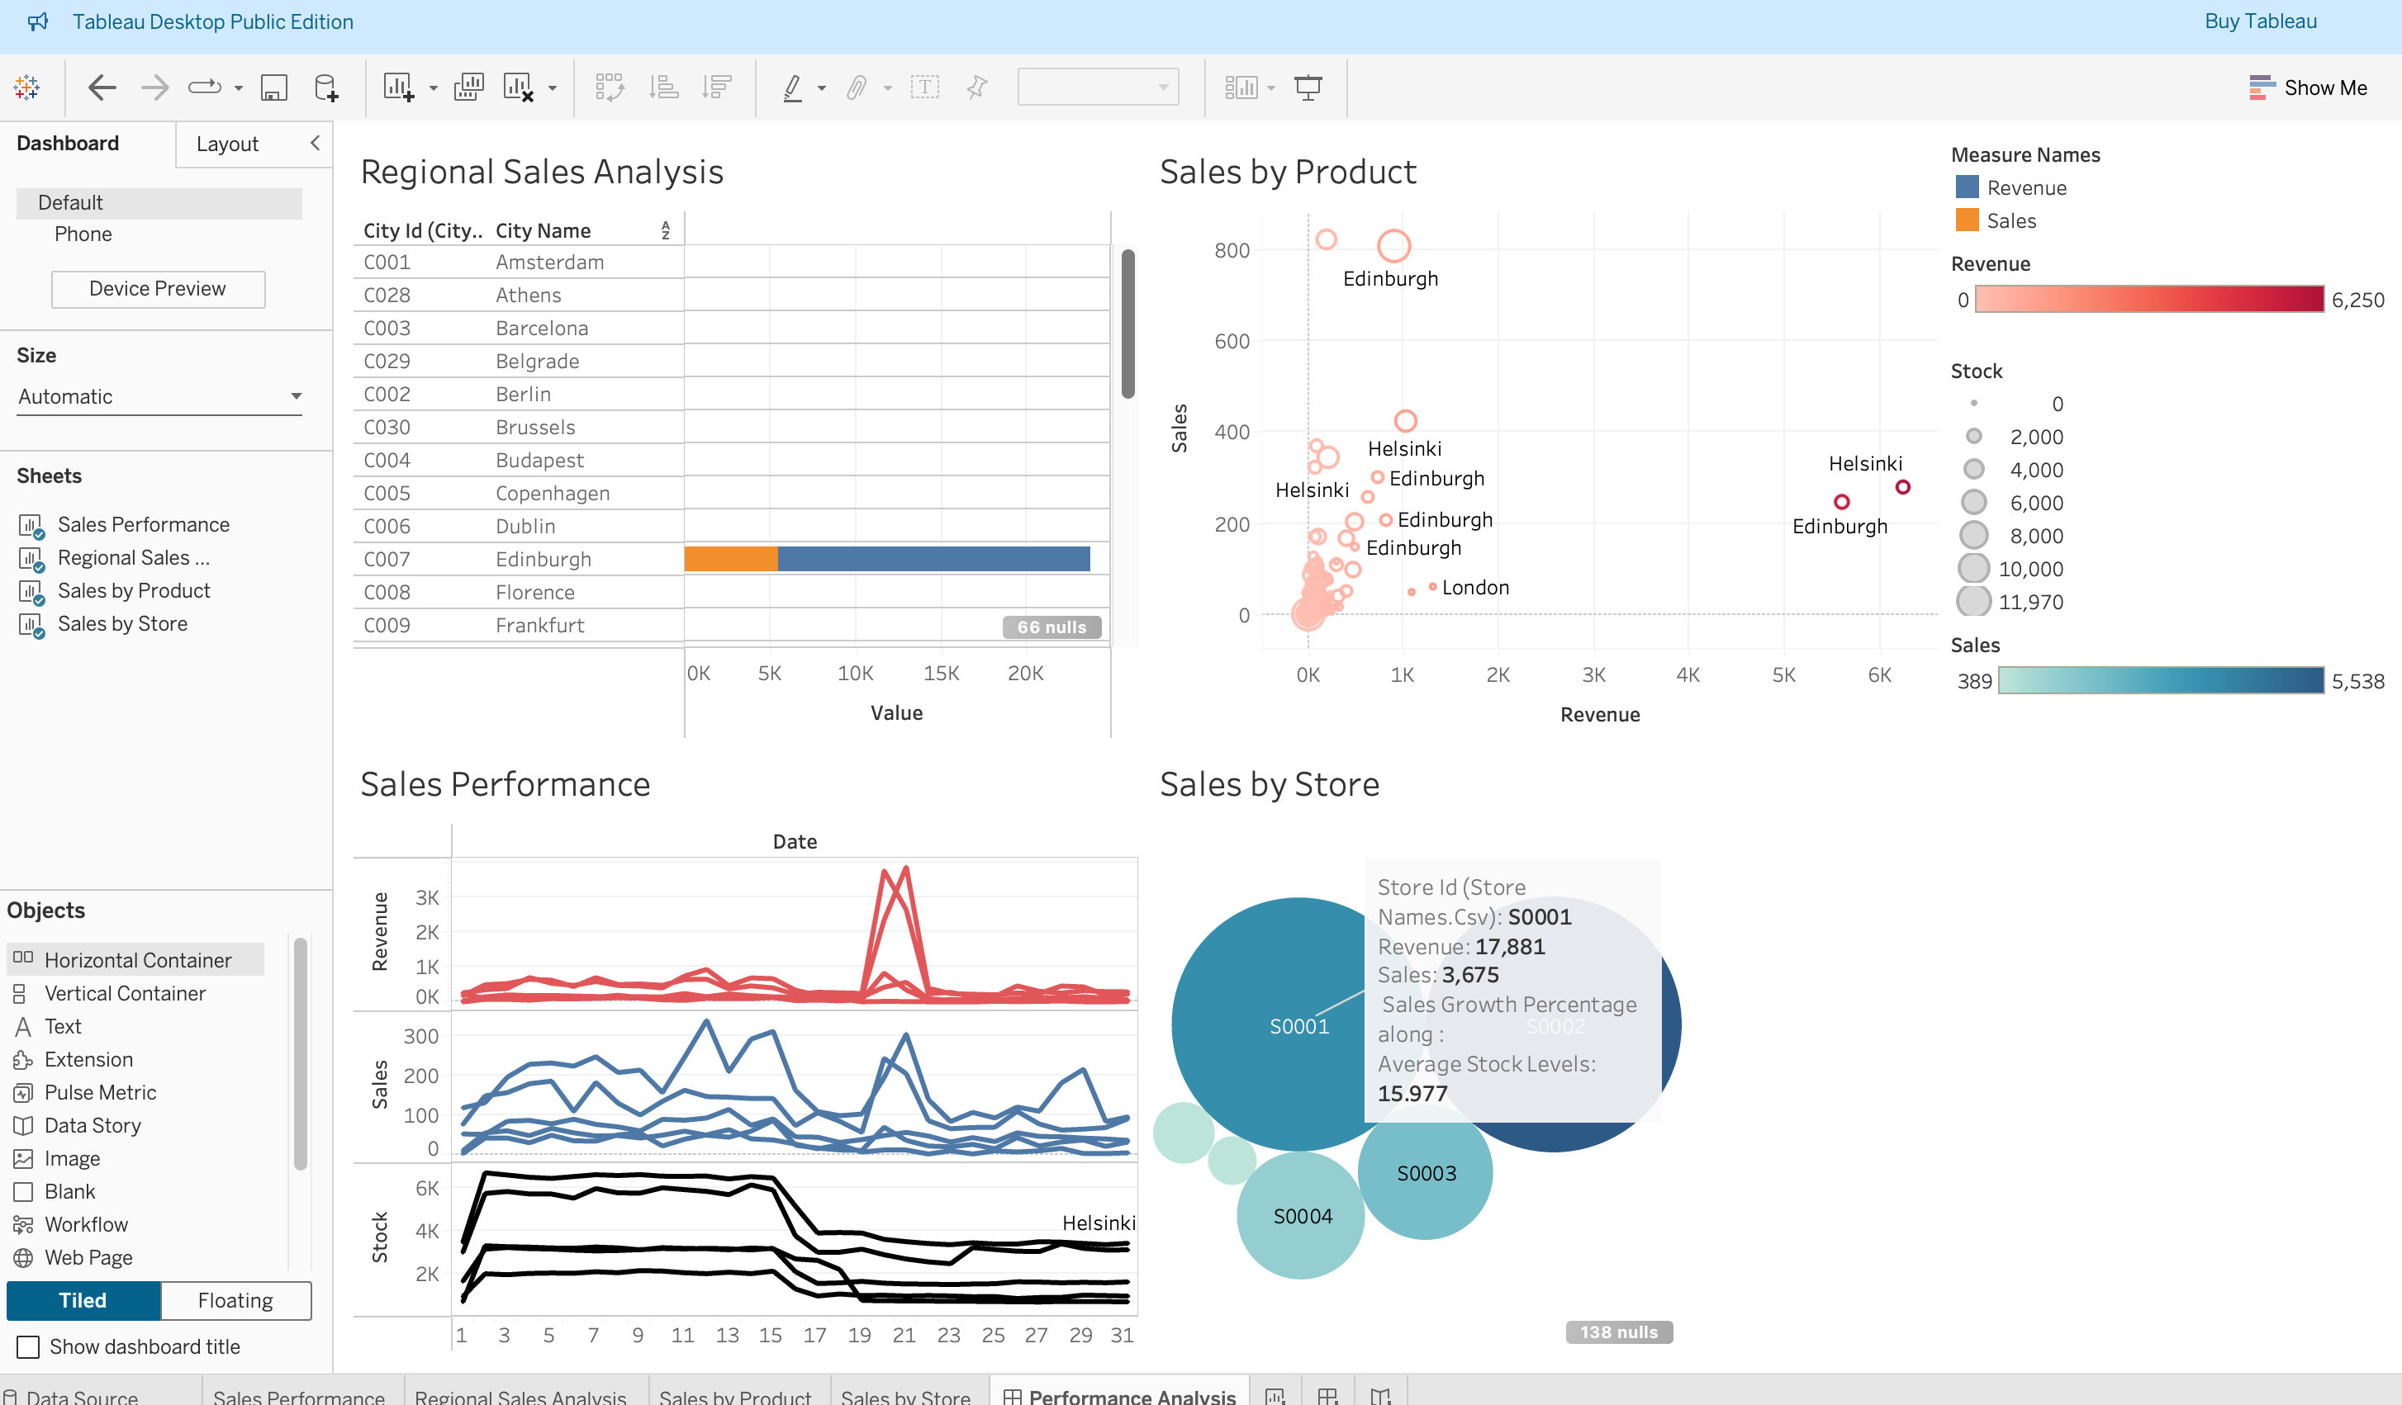
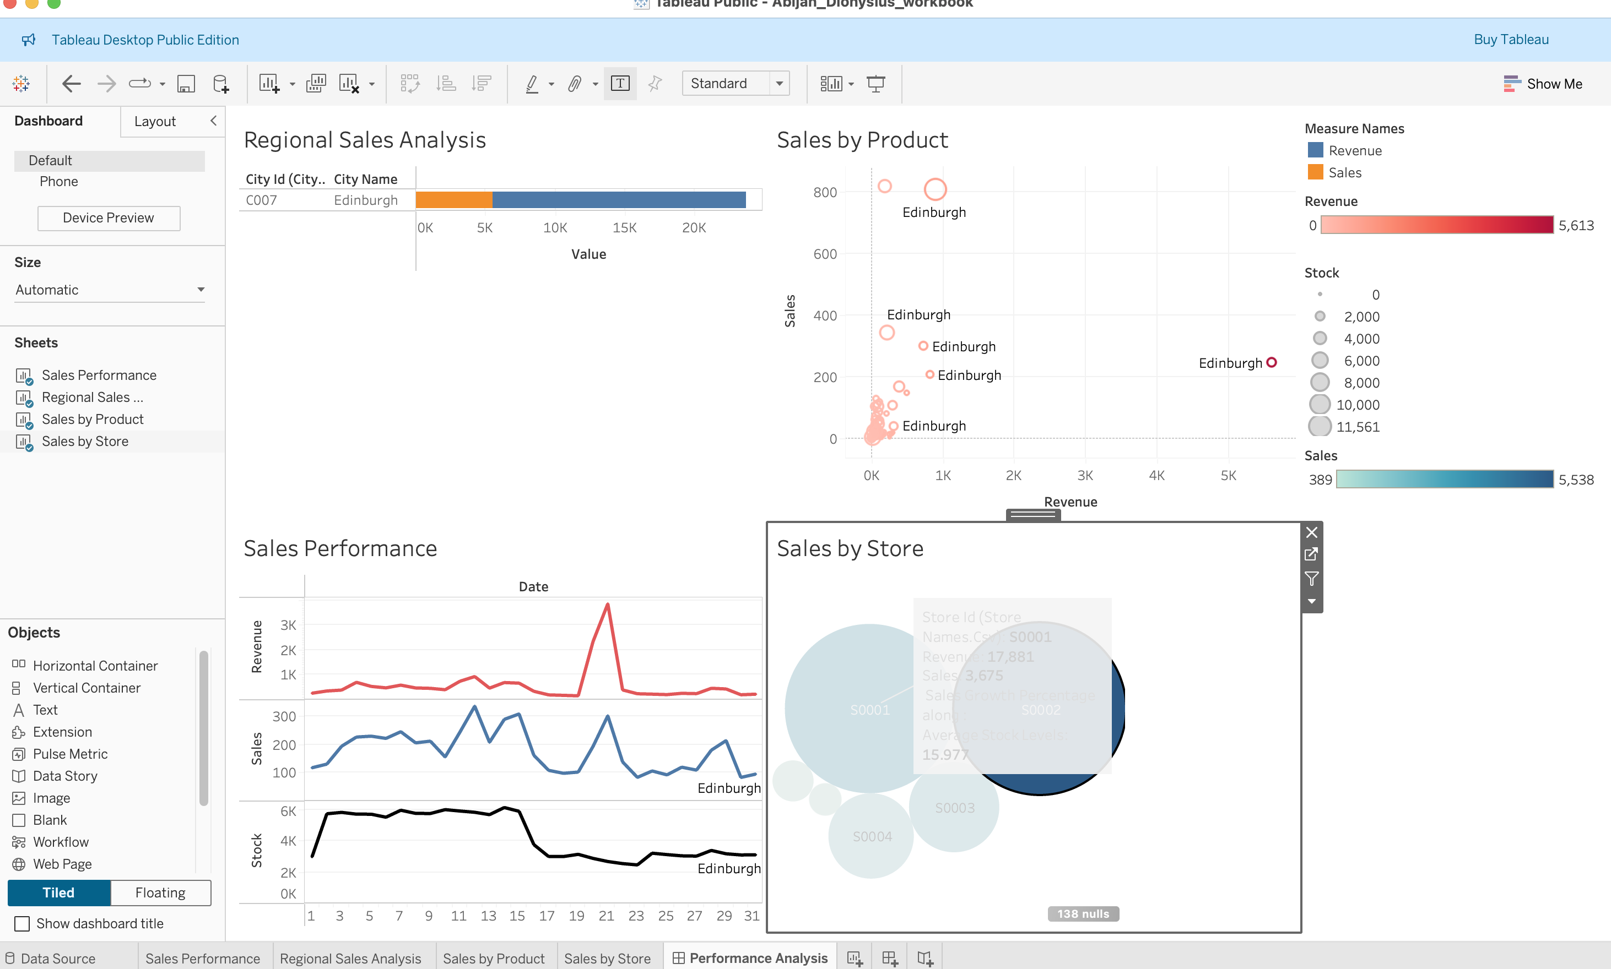
Module 4, Lesson 2: Advanced Visualizations Using Tableau

Slide 20

Discussion

Slide 21
Insights and Recommendations
Revenue is the Most Important Factor:
The analysis shows that revenue has a strong and direct impact on sales. As revenue increases, sales also increase significantly.
Implication: The retail chain should focus on strategies to boost revenue, such as promotions, targeted marketing, and expanding product offerings.
Having more stock available contributes positively to sales. When stock levels increase, sales also go up.
Implication: Ensuring that popular products are always in stock can help maintain and boost sales.
Higher prices tend to reduce sales. Even small price increases can lead to a noticeable drop in sales.
Implication: The retail chain should consider competitive pricing strategies and discount offers to attract more customers.

Slide 22

Conclusion

Slide 23
Summary
Key Findings:
Helsinki and Edinburgh have higher revenue despite moderate sales, suggesting high-value products or pricing strategies in these locations.
London and Saint Petersburg have relatively lower revenue compared to their sales volume, indicating lower pricing or smaller transaction values.
Stock levels vary, with some cities maintaining high stock levels but generating relatively lower revenue, suggesting inefficiencies in stock management.
Conclusion: The company should focus on optimizing pricing strategies in high-sales, low-revenue cities (e.g., London) and ensure efficient stock allocation based on revenue potential.

